Slide 1

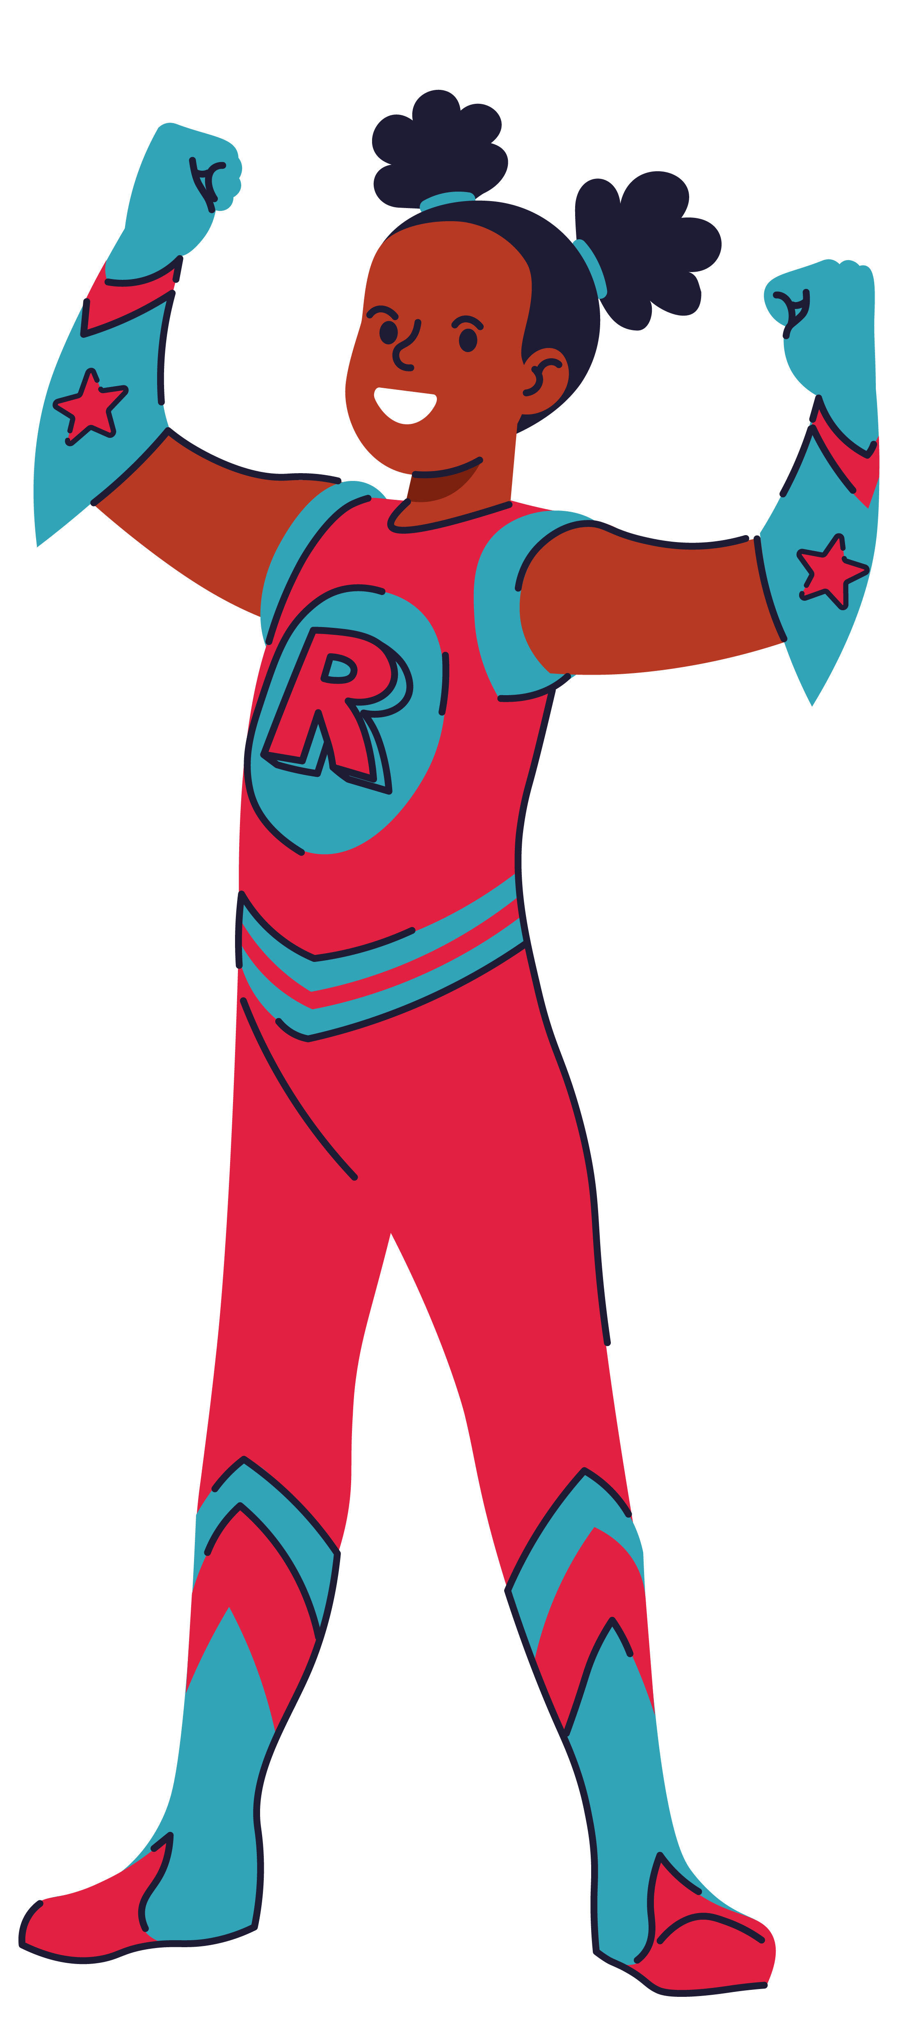
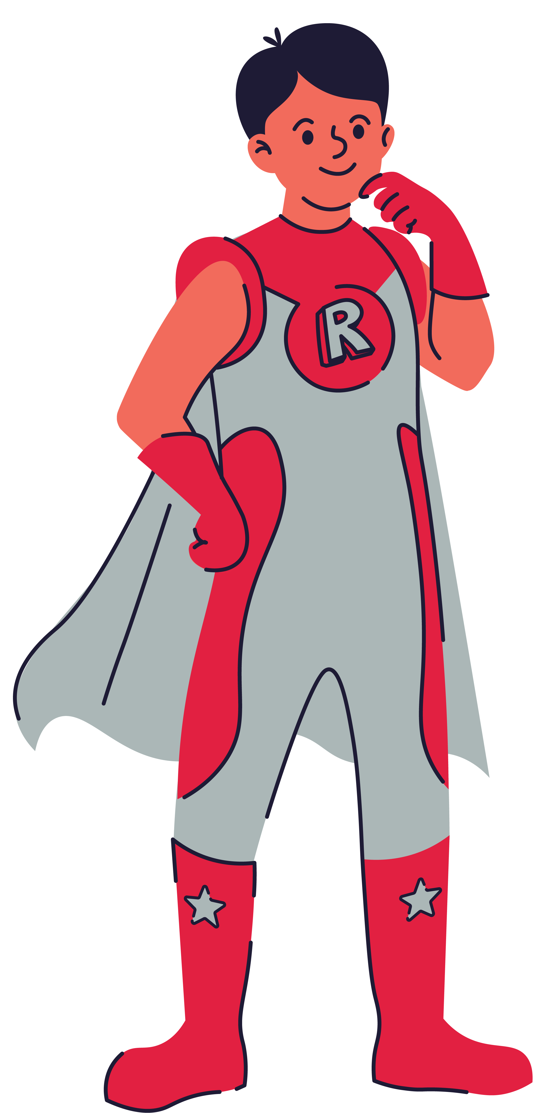
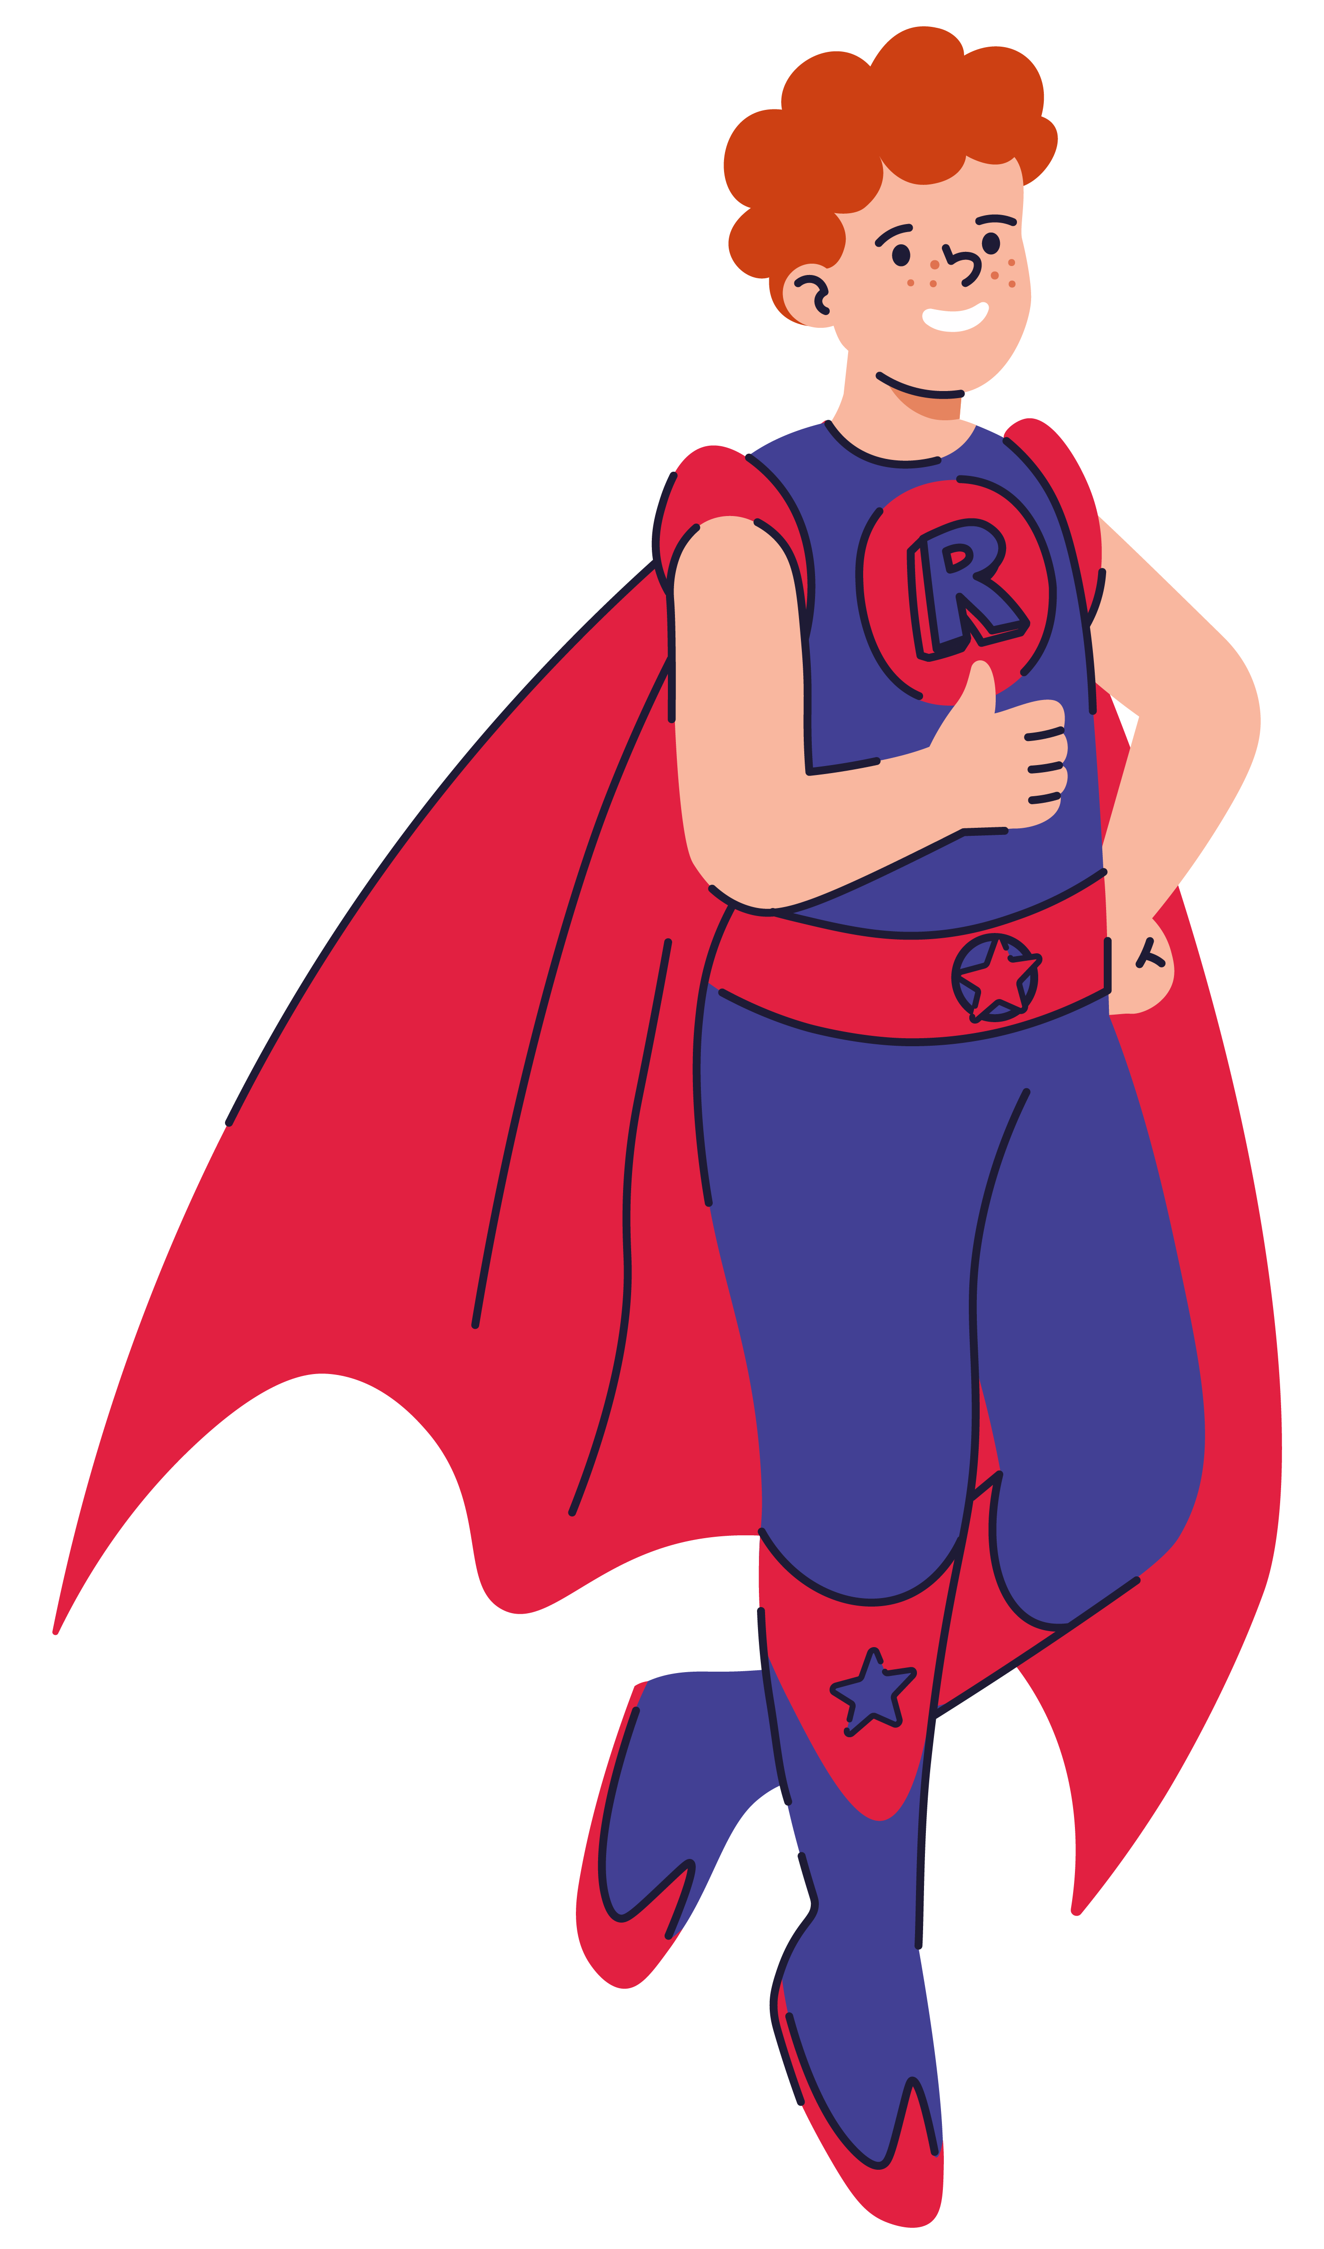


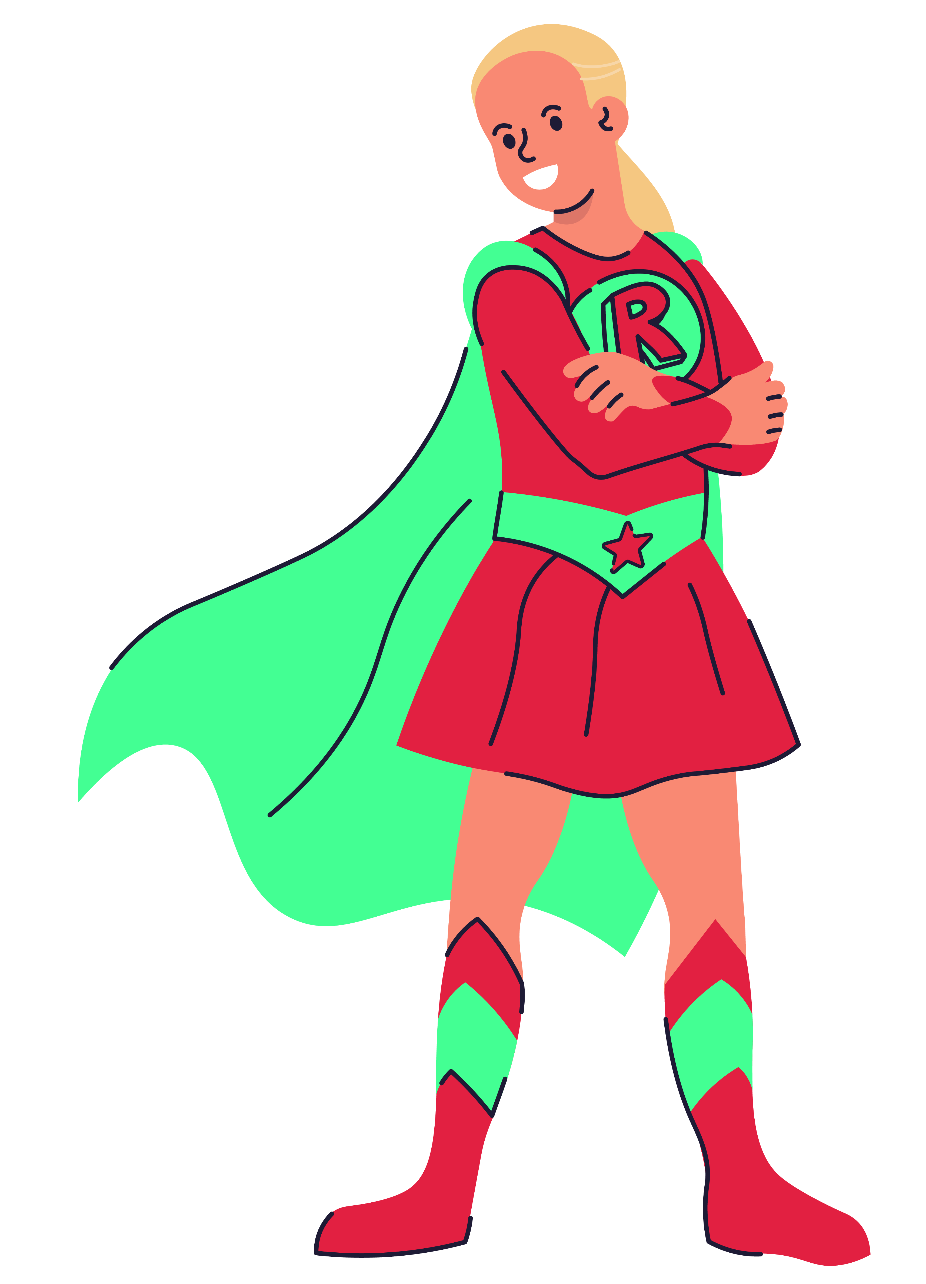





Slide 2
Be Responsible Show service towards others and uphold justice
Make good choices
Be a good role model
Do the best you can do
Be honest and truthful
Ezra 10:4 – “Arise! For this matter is your responsibility, but we will be with you; be courageous and act.”

Slide 3
Be Resilient Show Endurance
Don’t give up!
If you fail, try again.
Set goals and strive to achieve them
Don’t be afraid to ask for help
Joshua 1:9 – “I repeat, be strong and brave! Don’t be afraid and don’t panic, for I, the Lord, your God, am with you in all you do.”

Slide 4
Be Reflective Show wisdom
Look for and learn from mistakes
Remember past learning
Be inquisitive, ask ‘Why?’ and ‘How?’
Continually build on your knowledge
Romans 12:2 – “Do not be conformed to this world, but be transformed by the renewal of your mind, that by testing you may discern what is the will of God, what is good and acceptable and perfect.”

Slide 5
Be Respectful Show compassion and friendship
Listen and learn from others
Show tolerance for other points of view
Take care of possessions and your environment
Support others in their learning
Romans 15:1 – “Now we who are strong ought to bear the weaknesses of those without strength and not just please ourselves.”

Slide 6
Be Remarkable
Show creativity
Always challenge yourself, step outside your comfort zone
Be brave in your choices; be different and unique
Use your imagination
Share your skills and talents with others
Timothy 4:14 – “Do not neglect the gift you have, which was given you by prophecy when the council of elders laid their hands on you.”

